Slide 1

Best UPSC Coaching Classes in Andheri
The Prayas India - Best UPSC CSE Coaching Institute in Mumbai.
The Prayas UPSC CSE Online Live Preparation Course.
The Prayas IAS Mains Answer Writing Program
GS, Prelims and Mains answer writing preparations
Guidance from experienced mentors, experts and Officers

Slide 2
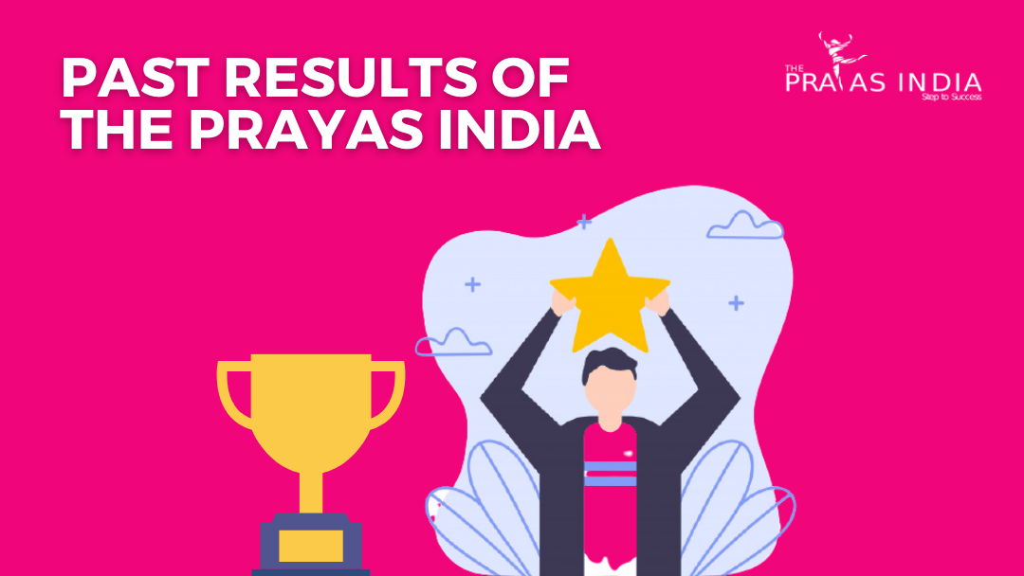
UPSC Coaching in Andheri
Daily Webinars on UPSC CSE Exams @ 3PM
Daily Updates on Latest Important Topics on Telegram Channels and Facebook
Daily Updates on Papers and Discussions and Home Assignments
Live Webinars and Previous Webinar Recordings on YouTube
Contact The Prayas India for - Form Filling Help and Guidance

Slide 3
UPSC Coaching in Andheri
The Prayas - IAS Mains Answer Writing Program
Phase-1 (8-10 Months): GS-I, II, III, IV + Prelims + Topic Wise Pre & Mains Questions Practices + Topic Wise Tests + Topic Wise Mains Answer Writing + Current Affairs + Previous Years Papers
Phase-2 (3 Months): Prelims Test Series +CSAT+ Revisions Only + 1 Yr. C.A
Phase-3 (2-3 Months): Mains Test Series + C.A
Phase-4: Interview Mocks

Slide 4
Best Civil Services Coaching Classes in Andheri
The Prayas India - Best UPSC CSE Coaching Institute in Mumbai.
100+ Students in Online Batches
Answer Writing Skill Development
Q&A sessions after Paper Solving
Discussion on Current affairs by experts.
Explanation on doubts and queries.

Slide 5
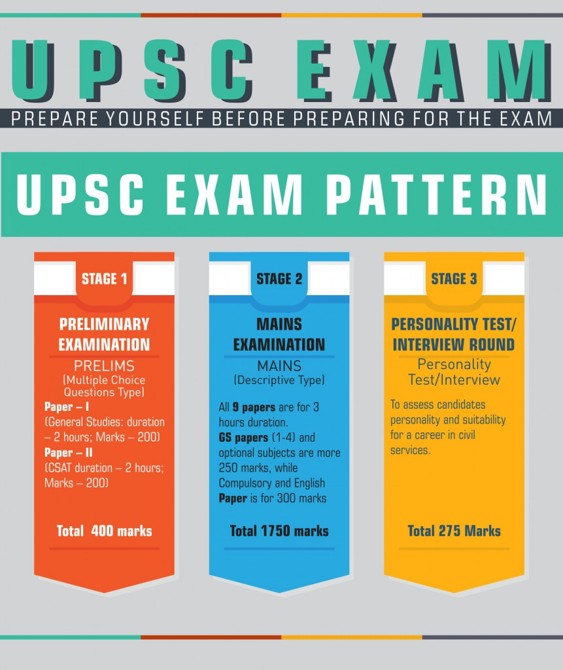
Top Civil Services Coaching in Andheri
The Prayas India - Best IAS, UPSC CSE, MPSC NDA, CDS, MBA Entrance Exams in Maharashtra.
International Education Conference & Awards, 2017
Global Education Excellence Award in Mumbai, 2017
The Rising Leadership Awards, 2017

Slide 6

Top Civil Service Coaching in Andheri
The Prayas- IAS Mains Answer Writing Program
300+ Mains Answer Writing Program
Answer Sheet Evaluation- Feedback on answers and proper guidance will be provided.
Live Lectures- For detailed discussion of questions

Slide 7

Top IAS Coaching in Andheri
The Prayas India: Top UPSC Coaching in Bhandup
Preliminary Examination (UPSC Prelim) – consist of 200 mark
Mains Examination (UPSC Mains)- consist of 1750 marks
UPSC Personality Test (UPSC Interview)- it is of 275 marks

Slide 8

Top IAS Coaching in Andheri
How was this course designed?
The Prayas ePathshala Research & Development team has done meticulous research to design this GS PCM Course. We have taken care previous years papers subject wise weightage, weightage of different topics of a subject, current affairs and relevant contemporary news and events.

Slide 9
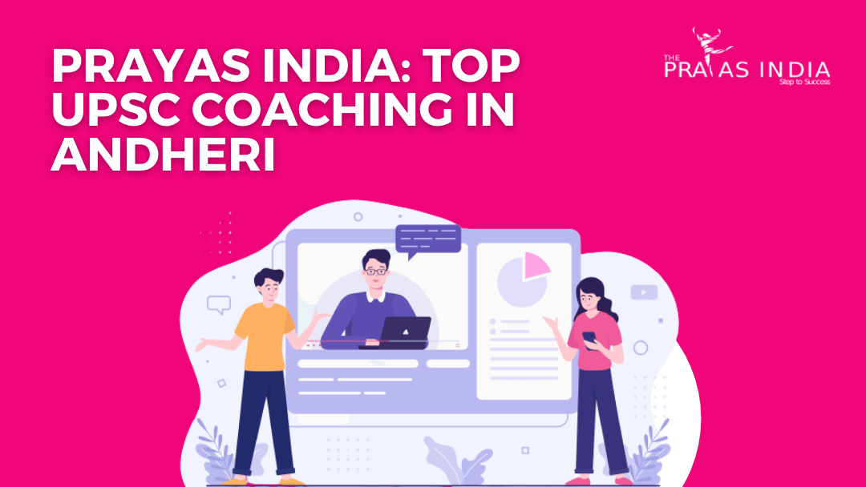
IAS Coaching in Andheri
Interview
The IAS Interview is of 275 marks.
It is conducted within the UPSC workplace in Delhi.
Also It takes place completely different |in several |in numerous} time slots unfold across different days.
UPSC POSTS – THREE STYLES OF CIVIL SERVICES

